Slide 1





Name of Project
Garbage Classification Using EfficientNetV2B2 with
Transfer Learning
Presented by: Ashritha Reddy Annareddy

Slide 2

learning Objectives
This project aims to
Understand the Role of AI in Environmental Sustainability
Master Image Classification Techniques
Data Collection & Preprocessing
Handle Class Imbalance
Implement Transfer Learning
Model Evaluation & Visualization
Real-Time Prediction and Deployment
Understand Ethical AI Practices
GOAL
Notes:
Learning Objectives of the Internship: Garbage Classification Using Deep Learning
1. **Understand the Role of AI in Environmental Sustainability**
Learn how artificial intelligence and image classification can be applied to promote waste management and environmental protection.
2. **Master Image Classification Techniques**
Gain practical experience in building and training image classification models, especially Convolutional Neural Networks (CNNs) and transfer learning using models like EfficientNet.
3. **Data Collection & Preprocessing**
Learn how to collect, clean, label, and preprocess image data for training AI models effectively (e.g., resizing, normalization, augmentation).
4. **Handle Class Imbalance**
Explore techniques such as data augmentation, weighted loss functions, and oversampling to manage class imbalance in garbage datasets.
5. **Implement Transfer Learning**
Apply pre-trained models like EfficientNetV2B0/B2 to improve model performance and training efficiency on limited garbage classification data.
6. **Model Evaluation & Visualization**
Learn how to evaluate model performance using metrics such as accuracy, confusion matrix, and classification reports, and visualize results using tools like Matplotlib and Seaborn.
7. **Real-Time Prediction and Deployment**
Deploy the trained model using tools like **Gradio**, enabling real-time garbage image classification via a web interface.
8. **Understand Ethical AI Practices**
Gain awareness of the ethical implications of AI in environmental systems, including data privacy, model bias, and transparency.
9. **Documentation and Reporting**
Develop skills in documenting the end-to-end process, including dataset preparation, model training, results, and deployment steps for academic and professional presentation.
10. **Teamwork & Communication**
Improve collaboration and communication skills by working with mentors, peers, or stakeholders during the internship project.

Slide 3
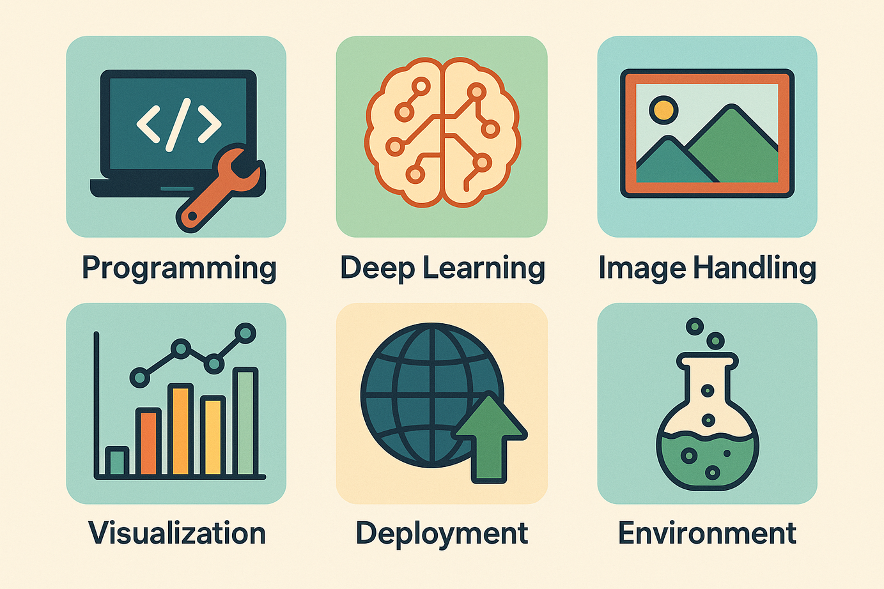
Tools and Technology used
🔧 Tools and Technologies Used
Python – Programming language for model development
TensorFlow & Keras – Deep learning framework for training EfficientNetV2B0
Gradio – Web interface for image classification
Matplotlib & Seaborn – Visualization of accuracy, loss, and confusion matrix
Google Colab – GPU-enabled environment for model training

Slide 4
Methodology
🔍 Problem Definition
Build a deep learning model to automatically classify garbage (e.g., plastic, metal, organic, etc.) for better waste segregation and recycling.
📁 Data Collection
Collected labeled garbage images from open sources; organized them by class folders for model input.
🧹 Data Preprocessing
Resized images (e.g., 224×224 for EfficientNet)
Split into train/validation/test sets
Applied augmentation (flip, rotate, zoom)
Handled class imbalance using weights/oversampling
🧠 Model Building
Model 1: Custom CNN with Keras Sequential
Model 2: EfficientNetV2B0/B2 with transfer learning
Added custom classification layers
Base frozen or fine-tuned based on performance

Slide 5
Methodology
🚀 Model Training
Used categorical cross-entropy loss and Adam optimizer
Applied EarlyStopping and ModelCheckpoint to avoid overfitting and save the best model
📊 Model Evaluation
Evaluated with accuracy/loss curves, confusion matrix, and classification report
Visually verified predictions on test images
🌐 Deployment
Deployed EfficientNetV2B2 using Gradio
Created a web interface for real-time image classification
📝 Documentation
Documented the full workflow with code, visuals, and analysis
Highlighted key observations and challenges resolved

Slide 6
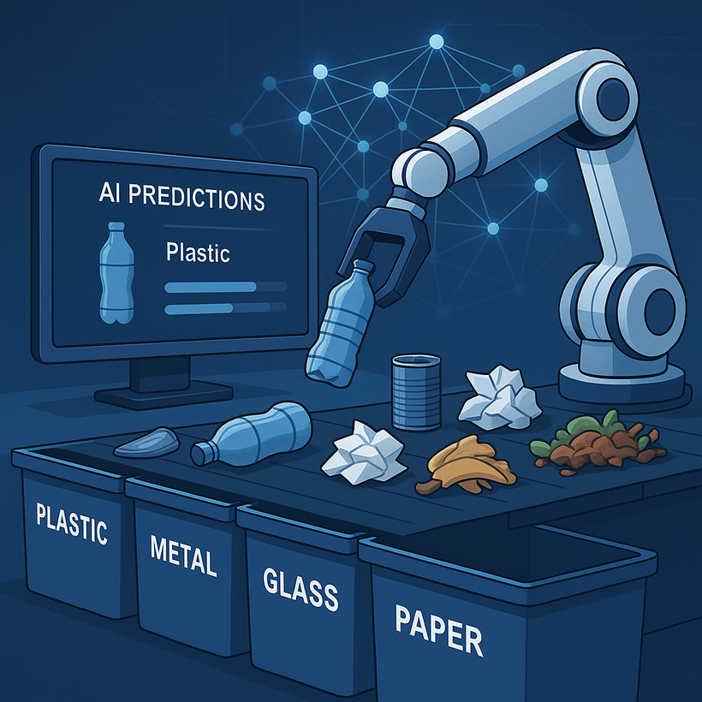
Problem Statement:
Improper segregation of waste is a major challenge in effective waste management, leading to environmental pollution, health hazards, and inefficient recycling. Manual sorting is time-consuming, inconsistent, and often unsafe for workers.
To address this issue, there is a need for an automated system that can accurately classify different types of garbage based on images. The goal of this project is to develop a deep learning-based image classification model that can automatically identify and categorize garbage into various classes such as plastic, metal, glass, organic, and paper. This system can support smart waste management solutions and assist in real-time waste segregation for recycling and disposal.

Slide 7
Why Use EfficientNetV2B2?
Balanced Performance
Great trade-off between speed and accuracy
Scalable
Suitable for moderately complex datasets
Pretrained on ImageNet
Solid backbone for transfer learning tasks
Efficient
Faster convergence with fewer resources needed

Slide 8
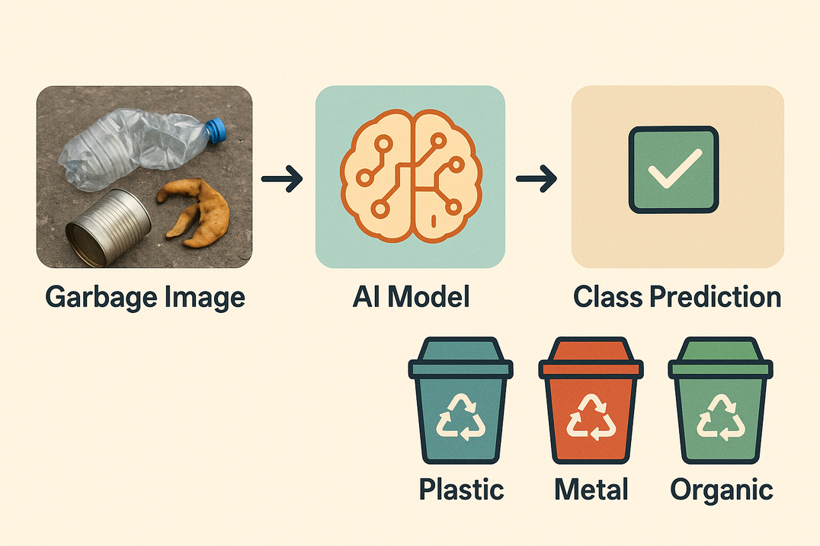
solution
To address this, we propose an AI-based garbage classification system that:
✅ Uses deep learning (EfficientNetV2B2) to classify waste images into categories like plastic, metal, organic, paper, and glass.
🔁 Employs transfer learning for fast, accurate training on limited data.
⚙️ Handles class imbalance using augmentation and weighted loss.
🌐 Deploys a real-time interface using Gradio to make predictions from user-uploaded images.
📊 Improves accuracy over manual classification and supports smart waste management systems.

Slide 9
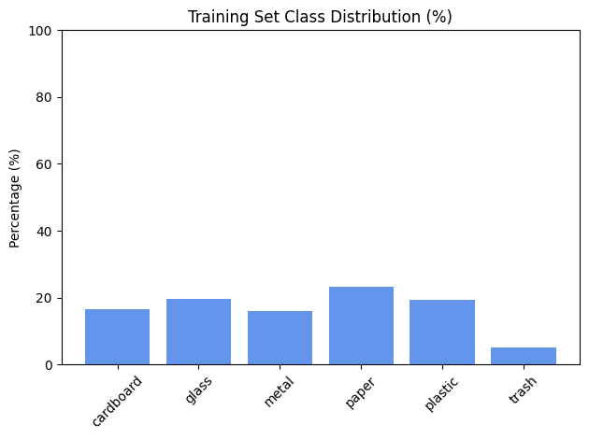
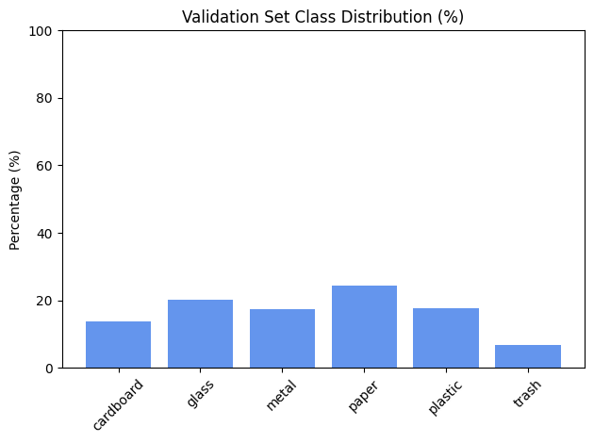
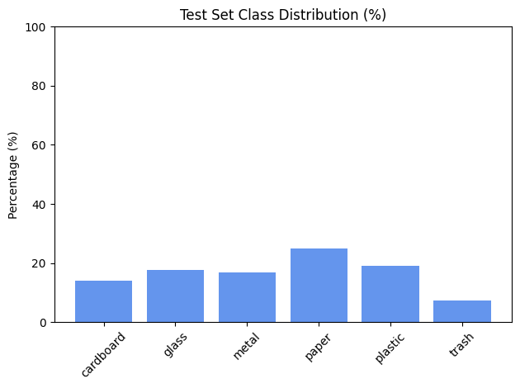

Class Distribution Across Dataset Splits

Slide 10
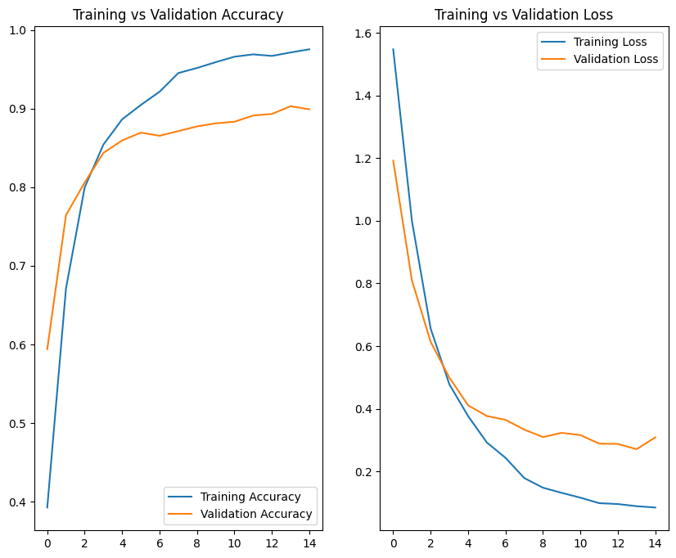
Model Accuracy & Loss Curves

Slide 11
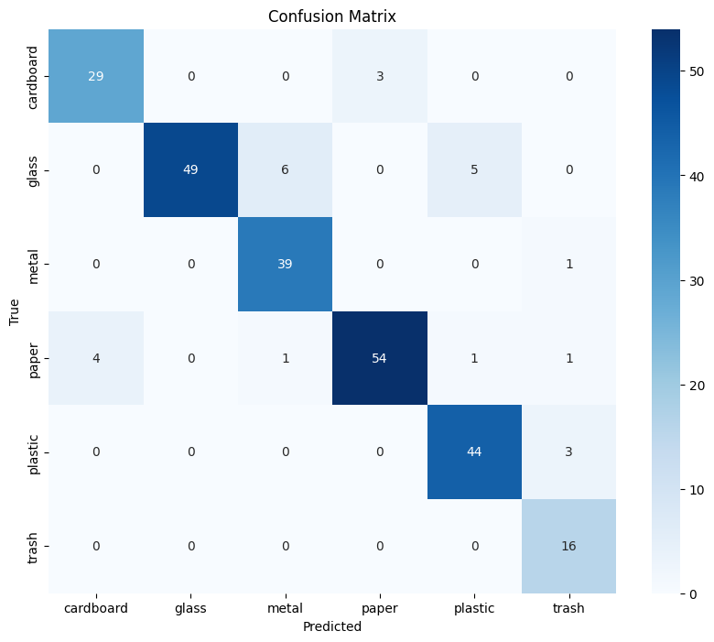
Evaluation Metrics

Slide 12
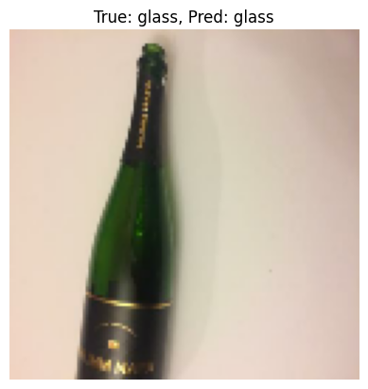
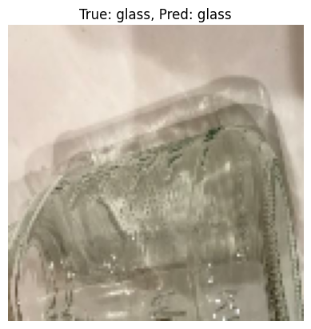
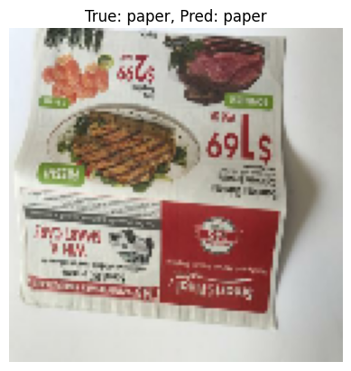
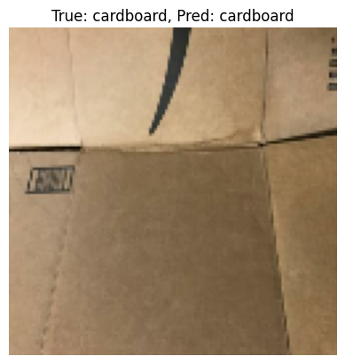
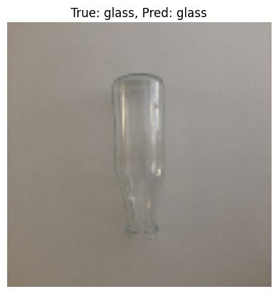
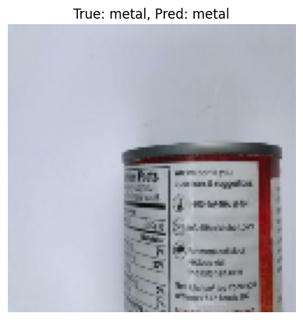
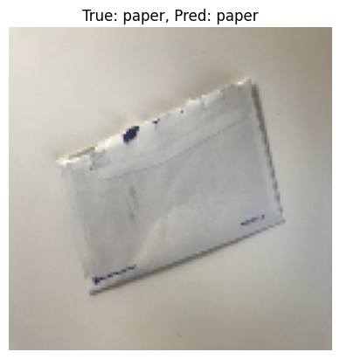
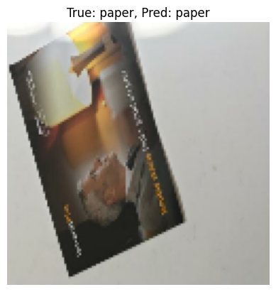
Screenshot of Output:

Slide 13
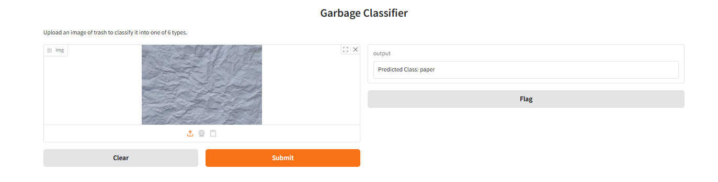
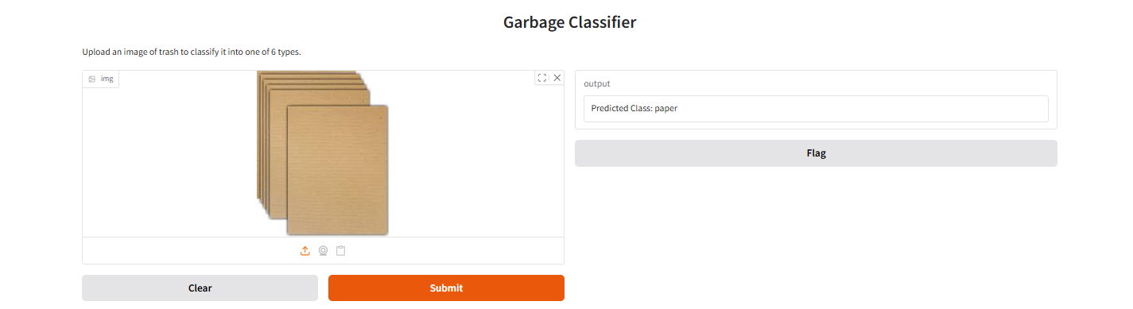
Evaluation Metrics

Slide 14
Conclusion:
Key Achievements: Developed an image classification model using EfficientNetV2B2 for automatic garbage classification. Achieved ~97% validation accuracy with robust performance across multiple waste categories. Handled class imbalance and applied image augmentation to improve generalization. Deployed the model using Gradio for real-time user interaction via a web interface. | Learning Outcomes: Understood and implemented transfer learning in a real-world environmental context. Gained hands-on experience with TensorFlow, Keras, data preprocessing, and model deployment. Learned to evaluate model performance using accuracy, loss curves, confusion matrix, and classification metrics. | Future Scope / Improvements: Extend to multi-label classification for mixed-waste scenarios. Integrate with IoT smart bins for real-time smart city applications. Improve model robustness with a larger and more diverse dataset. Add bounding box detection for localizing waste in images.

